Slide 1
Wine Quality
Contents
A Data Science Approach
February 2022
Produced by George Lee

Slide 2
Overview
Wine quality can be highly subjective and it is impossible to taste every bottle of wine produced every year. In an effort to predict wine quality a dataset of 1500+ records containing physico-chemical properties of red wine and their rated quality. A regression model is used to predict their quality rating.
A brief overview of the approach and model vetting criteria:
Features and sales data is segmented in to model training and model testing data groups.
Model built on training data then deployed against testing data to identify the variance between actual and model predictions.
Model Vetting Methods:
Coefficient of Determination R² measures the percentage of variation between predicted and actual quality that can be explained by the features in our model.
Mean Absolute Error measures the average variance between predicted and actual quality.

Slide 3
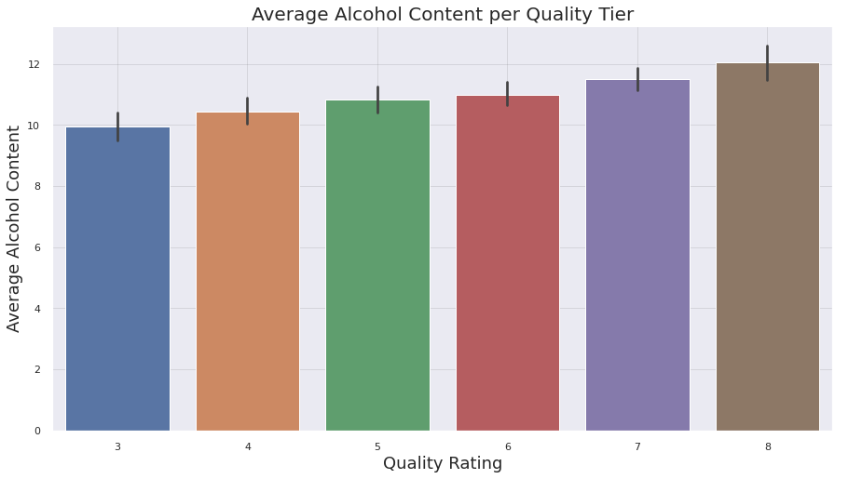
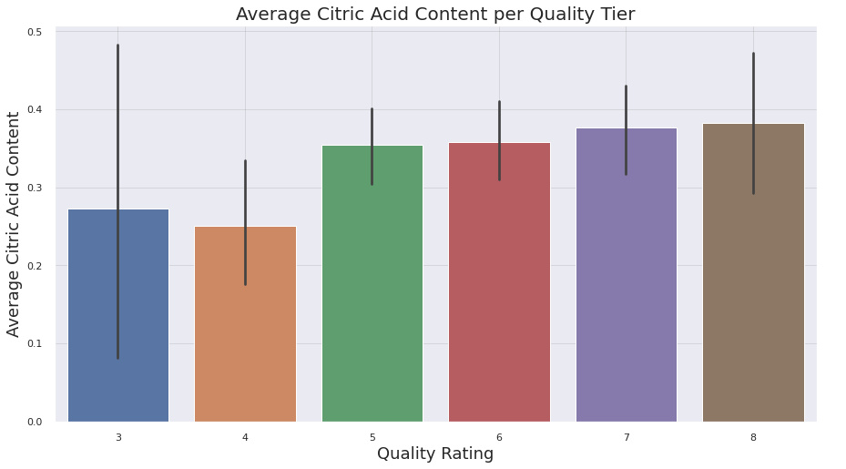
Trends
Alcohol and citric acid content trend with wine quality.
There is a clear step up in the average alcohol content with the quality rating of the wine.
Average Citric Acid adds a fruitfulness to the taste and trends towards a higher wine quality.

Slide 4
Model Prediction Performance
XG Boost
Coefficient of Determination
Training R²: 51.3%
Testing R²: 33.6%
Mean Absolute Error (MAE)
Training MAE: 0.4
Testing MAE: 0.5
Random Forest
Coefficient of Determination
Training R²: 75.6%
Testing R²: 35.7%
Mean Absolute Error (MAE)
Training MAE: 0.3
Testing MAE: 0.5

Slide 5
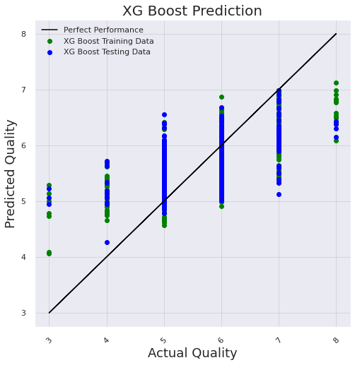
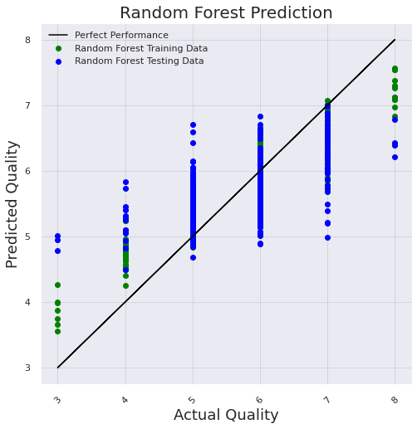
Visualizing Model Performance
XG Boost
Random Forest

Slide 6
Conclusion
Model Selection: Random Forest slightly better in all results.
Random Forest and XG Boost results are similar.
Random Forest performing slightly better than XG Boost.
Random Forest gives a wider distribution of predictions.
Recommendations
Choose wines with higher alcohol content and citric acid content.
Acquire larger dataset for further testing.

